Slide 1
BUSINESS PLAN FOR A BONSAI SHOP
INSTRUCTOR: Assoc.Prof.Dr.
TRAN HUU CUONG
GROUP : 08

Slide 2
STUDENT: le TUAN MINH
DINH QUYNH ANH
BUI THI KHANH LINH

Slide 3
01
Shop Description
02
Target Market
03
The competition
CONTENT
04
Marketing and Sales Plan
05
Operations
06
Management Structure
07
Financial

Slide 4
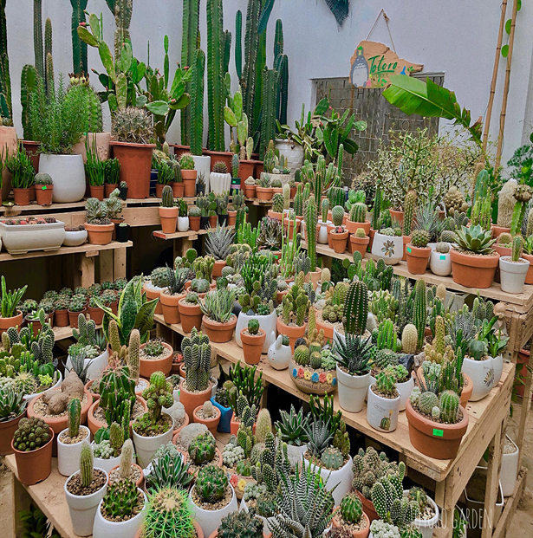
01. SHOP DESCRIPTION

Slide 5
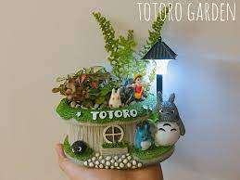
Name: Totoro Garden
Location: House D3 alley 88 Trung Kinh, Cau Giay, Hanoi.
Legal status: private shop
Tel: 862465789
Fan page FB: Totoro Garden
Objective:
Make profit from sell bonsai.
Provide mini plant pots products
Provide consulting services and customer care
Slogan: “Adding Green To Your Life”

Slide 6
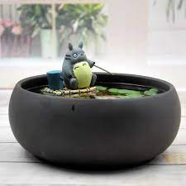
History and Development Stage: Established in July 2018 at house D3, alley 88, Trung Kinh Street - Cau Giay District - Hanoi city with 3 floors, total area 75m2. Industry development: Our industry is private industry belongs to the type of business and our company business type is bonsai. Company’s funding: Personal savings of Mr. Anh Duc. This has amounted to 300 million VND. Product: Bonsai. For example: - Succulent plant - Fengshui trees - Hade trees......

Slide 7
02.
TARGET MARKET

Slide 8
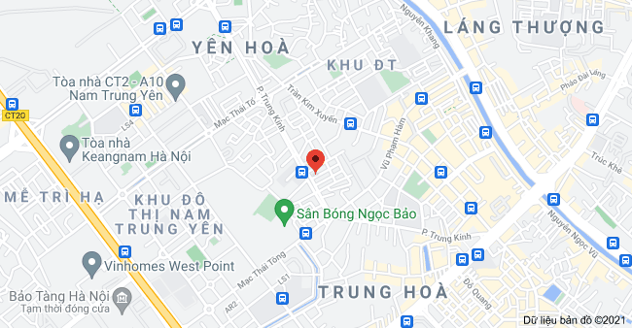
Target market location
At Yen Hoa Ward
It is urban area
Traffic patterns: Pedestrian, motorbikes, cars and more.

Slide 9




Customer characteristics:
01
Student: social labor student, high school in China. Young people, low income (1-3.5 million), 40% / day.
Two types of target customer:
02
Workers: middle age, higher income (5-10 million), 60% / day.
03
Gender: almost female
04
Hobbies: likes bonsai, wants to relax.

Slide 10
Customer motivations and purchasing patterns:
Motivation:
Have a loyalty card for loyal customers.
Free consultation and design for orders over 500000VND.
Purchasing patterns:
There are prices from low to high suitable for all customers.
We have a 1 month warranty card provided that we have to take care of it properly.

Slide 11
Market size:
ULSA has over 5000 students and growing potentially in the recent years.
Yen Hoa ward's population is 16670 people with increasing income.
Market trend:
In the future, the number of ULSA student increase.

Slide 12
03.
THE COMPETITION

Slide 13
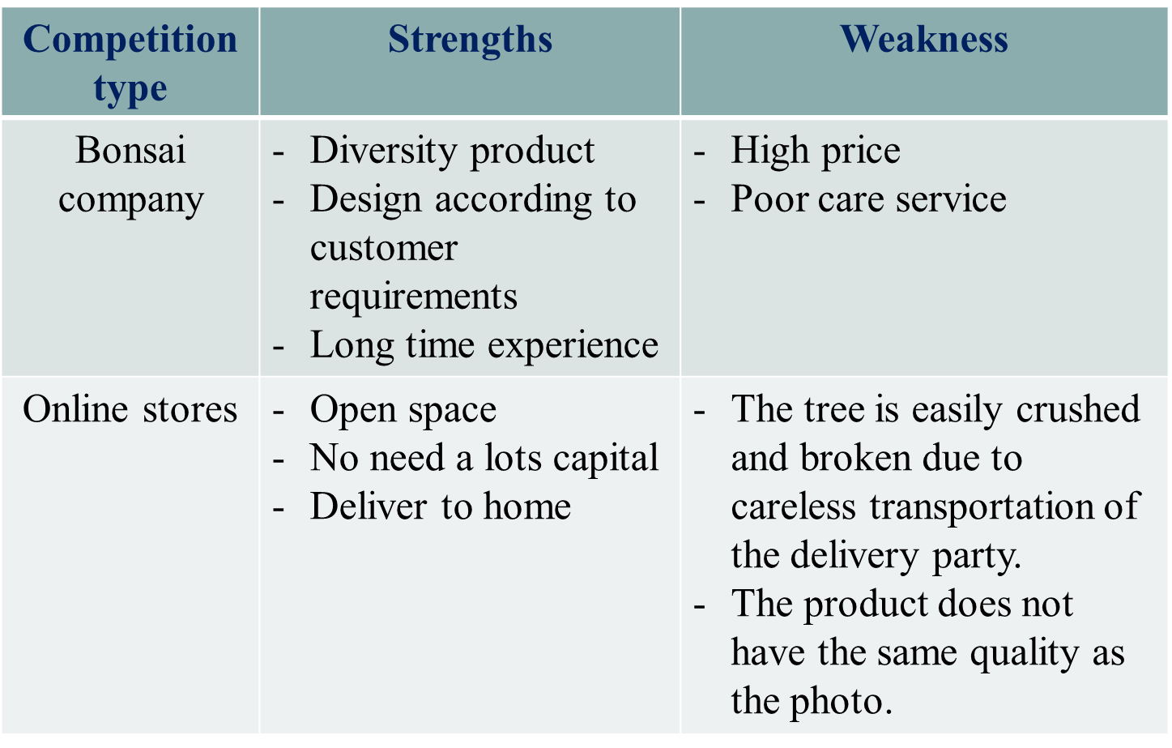

Slide 14

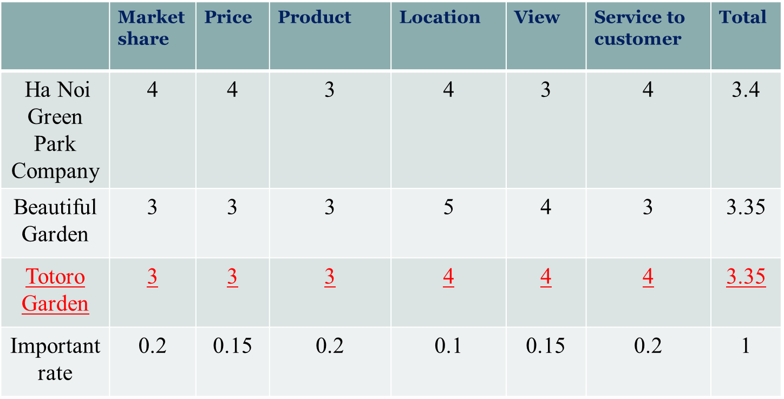

Slide 15
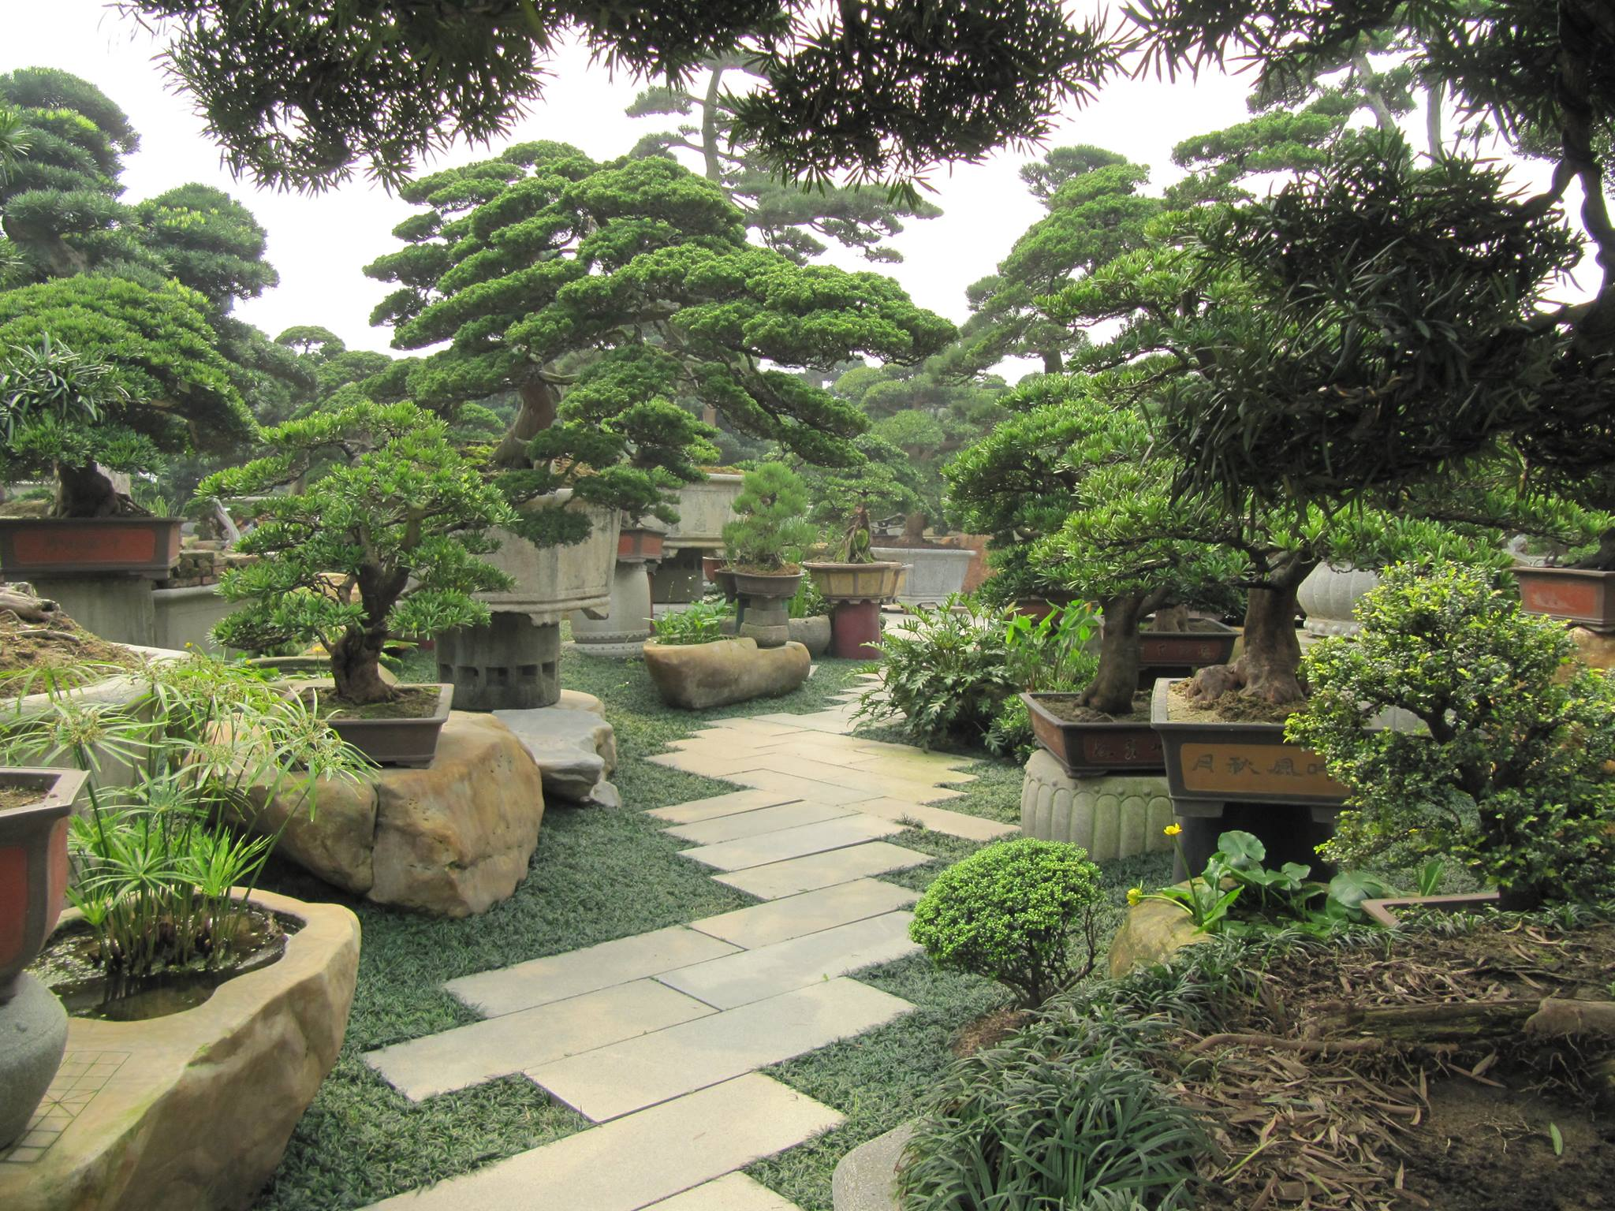

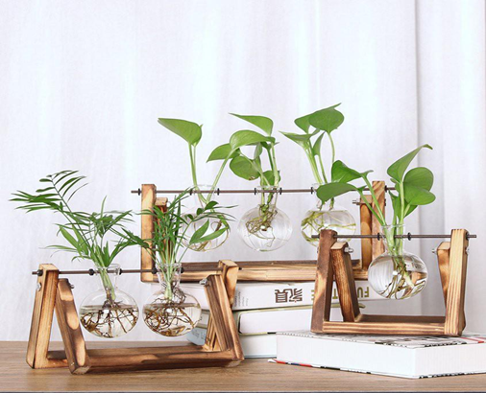

Ha Noi Green Park Company

Slide 16
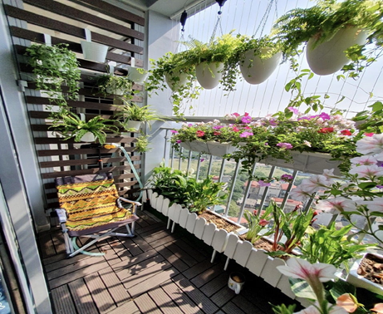
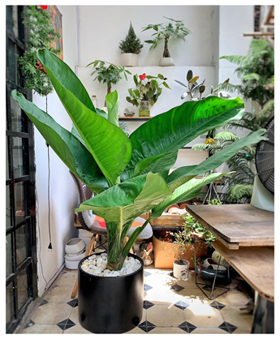
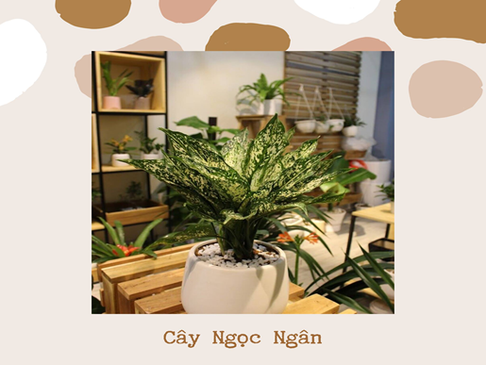
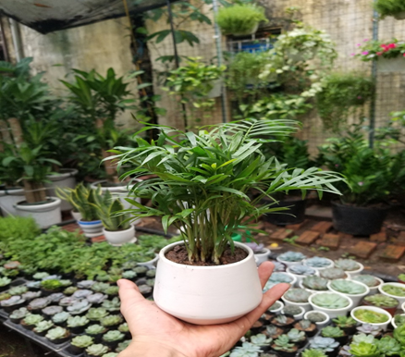
Beautiful Garden

Slide 17
SWOT
STRENGTH
The rich variety of trees Consulting shop that matches the style of the house
No ship
THREAT
Two strong competitors
Changing market tastes
WEAKNESS
OPPORTUNITY
Number of customer increase steady
Suitable price
Inability to mass product.

Slide 18

04. MAKERTING & SALE PLAN

Slide 19
LIST
STT | Tree name | Price ( VND ) | STT | Tree name | Price ( VND )
1 | Succulent plant | 15000 – 50000 VND | 8 | Shade tree | 500000 – 2000000 VND
2 | Table fengshui tree | 100000 – 300000 VND | 9 | Climbing flower tree | 100000 – 350000 VND
3 | Big pot fengshui tree | 300000 – 1000000 VND | 10 | Short – day tree | 15000 – 60000 VND
4 | Cactus | 30000 – 100000 VND | 11 | Land | 25000 VND/bag
5 | Carnation tree | 35000 – 90000 VND | 12 | Small Pots | 30000 – 100000 VND
6 | Pine | 100000 – 500000 VND | 13 | Large pots | 150000 – 500000 VND
7 | Rose | 10000 – 500000 VND | 14 | Decorative accessories | 10000 – 300000 VND

Slide 20
Current situation: 55 orders per day.
Goal: Sale increased 15% last month.
Total products expected: 83 orders per day and shipping throughout Vietnam
Marketing message: Nurturing green germs to radiate vitality.
MAKERTING & SALE PLAN

Slide 21
1. Product strategies
- The shop also provides a variety of plant pots, beautiful decorative accessories ...
- Print potted plants according to customer requirements.
- Plant mix plants according to customer requirements.

Slide 22

2. Price strategies
- 20% discount on the first Thursday of the month.
- Reduce the price on the special day: woman day, valentine day…
- Take care of customers by accumulating point, discount on their birthday.

Slide 23
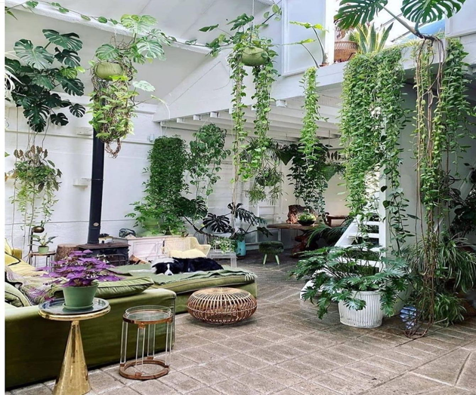
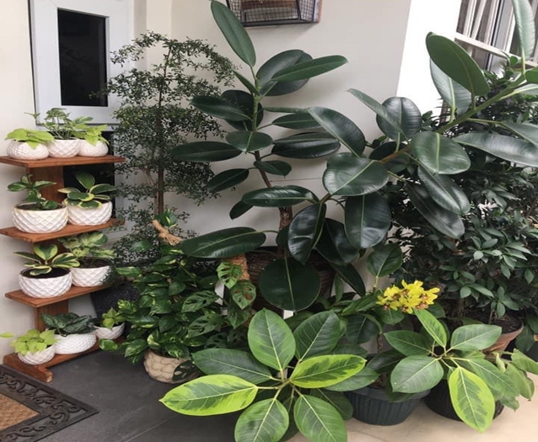
3. Place strategies
In the main road, people easy come to shop to buy bonsai.
Decorate room follow the trend.

Slide 24

4. Promotion strategies
Check in and review 5 stars on face book will get discount 10%.
Small gift in birthday, valentine day, woman day..

Slide 25
05.
OPERATION

Slide 26
1. Location/Facilities
One shop.
Designed suitable for both shopping and relaxation.
1 floor for fengshui, 1 floor for lotus, 1 floor for potted plants and planting applications, maximum 20 guests / floor.
2. Production
Product will be prepared directly when customer order.
By choosing import markets and checking products carefully before importing.

Slide 27
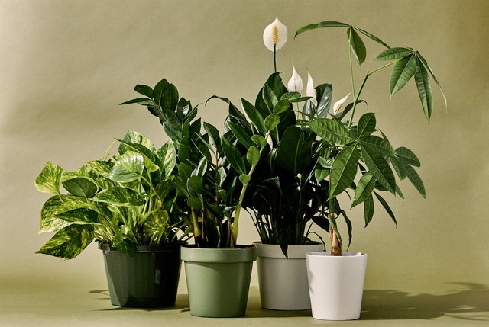
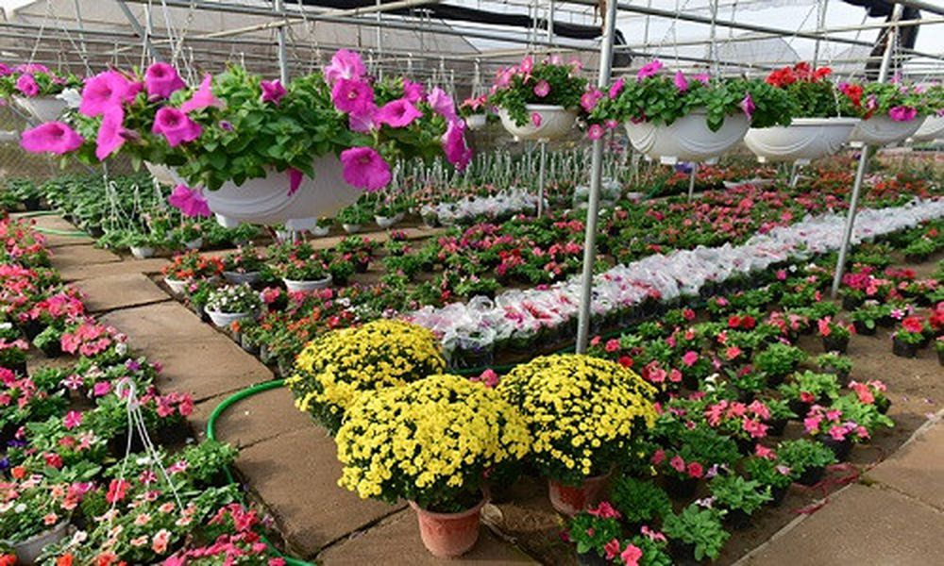
4. Customer service
Save customers vehicles carefully when they come.
3. Supply/Distribution - Supply: Ingredients imported from traditional flower villages such as Me Linh - Hanoi and Van Giang - Hung Yen.
- Working time: from 8 a.m – 20 p.m

Slide 28
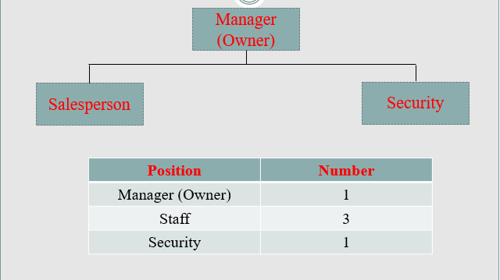
06. MANAGEMENT STRUCTURE

Slide 29
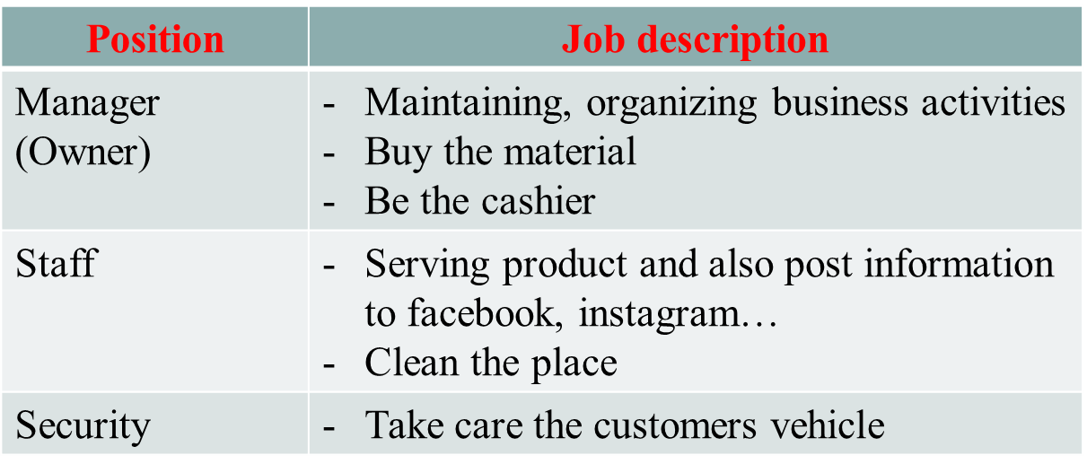
JOB DESCRIPTION

Slide 30
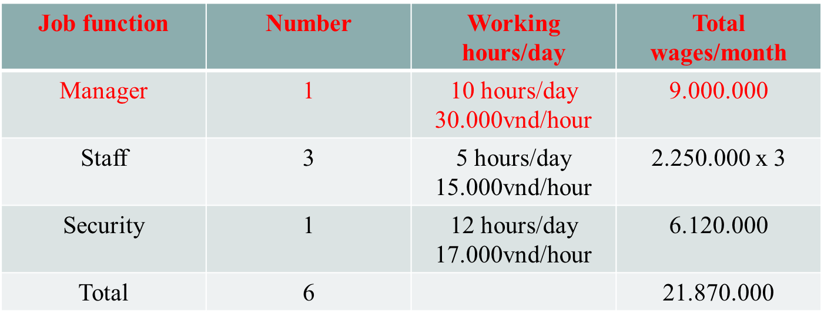

Slide 31
07. FINANCIAL

Slide 32
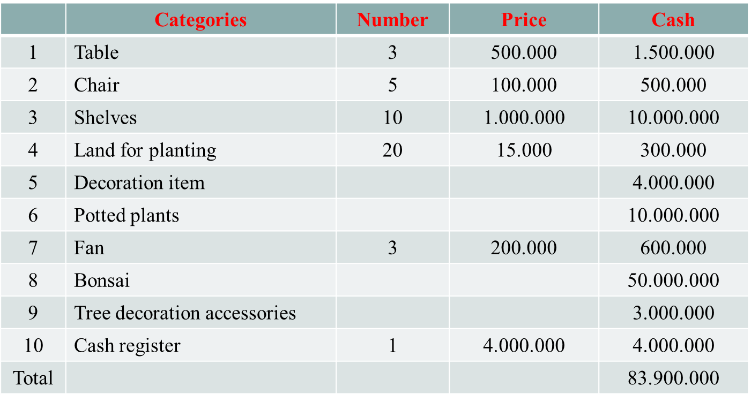
ESTIMATED ASSET

Slide 33
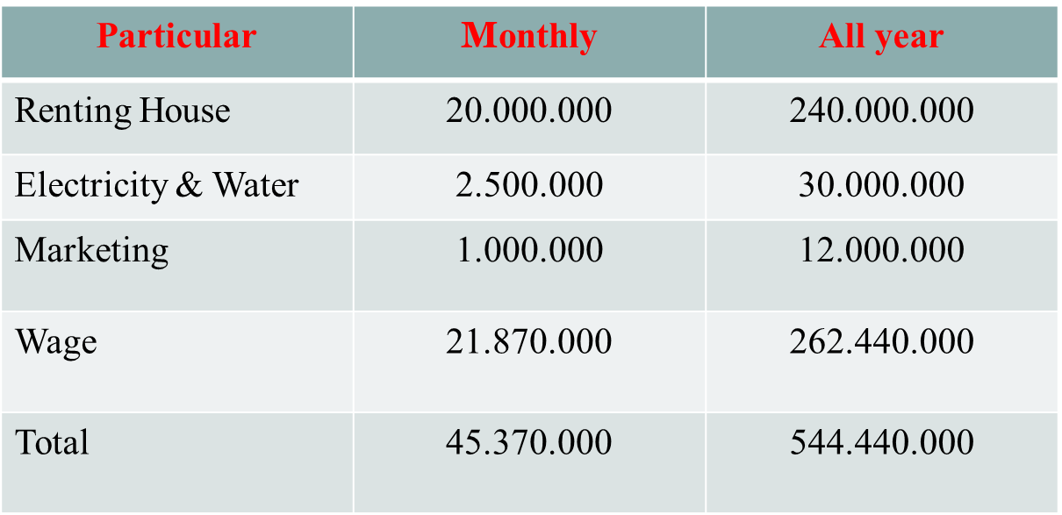
ESTIMATED COST

Slide 34
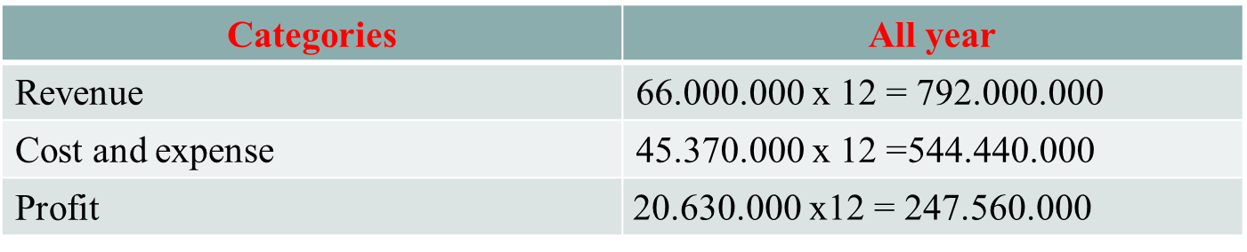
INCOME STATEMENT

Slide 35


